Slide 1
Introduction to Embedded C Programming.

Slide 2
Introduction
Programming is the process of creating a set of instructions that tell a computer how to perform a task.
Programming can be done using a variety of computer programming languages, such as JavaScript, Python, C and C++.

Slide 3
Embedded C programming
Embedded C is one of the most popular and most commonly used Programming Languages in the development of Embedded Systems.
An Embedded System is a system which has both the hardware and software and is designed to do a specific task.
Embedded Software or Program allow Hardware to monitor external events (Inputs) and control external devices (Outputs) accordingly.

Slide 4
Embedded C programming cont…
A software program is written on a special IDE (Integrated Development Environment) on a computer and uploaded to the microcontroller for execution.
Embedded C is basically an extension to the Standard C Programming Language with additional features.
It uses the same syntax and semantics of the C Programming Language like main function, declaration of datatypes, defining variables, loops, functions, statements, etc.

Slide 5
Parts of Arduino Program
Arduino program can be divided in three main parts;
values(variables and constants),
structure and
functions.

Slide 6
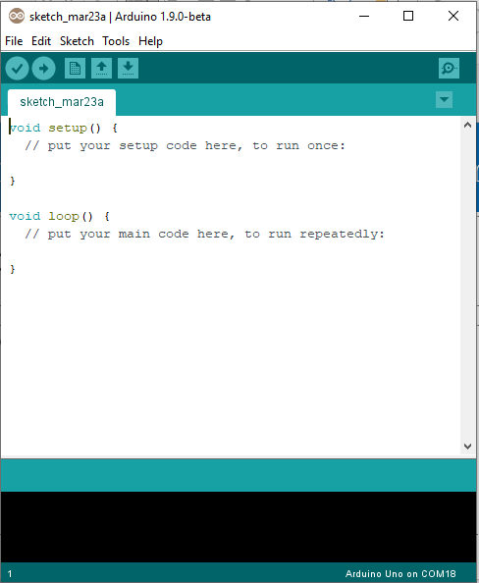

Slide 7
Variables(constants & data types)
Constants
HIGH | LOW
INPUT | OUTPUT
true | false
integer constants
floating point constants, etc.

Slide 8
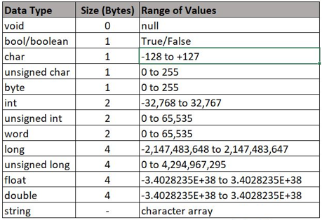
Data types

Slide 9
Some functions in Arduino program
pinMode()
It configures the specified pin to behave either as an input or an output. Eg. pinMode ( ledPin, OUTPUT);
digitalWrite()
Write a HIGH or a LOW value to a digital pin.
Eg. digitalWrite (ledPin, HIGH);
digitalRead()
Reads the value from a specified digital pin, either HIGH or LOW.
Eg. digitalRead(pin);

Slide 10
Functions in Arduino program cont…
analogRead()
Reads the value from the specified analog pin.
eg. float value=analogRead (inPin);
analogWrite()
Writes an analog value (PWM wave) to a pin.
eg. analogWrite (ledPin, Value/4);

Slide 11
Time functions
delay()
Pauses the program for the amount of time (in miliseconds) specified as parameter. (There are 1000 milliseconds in a second.)
eg. delay(1000);
delayMicrosecods()
Pauses the program for the amount of time (in microseconds) specified as parameter. There are million microseconds in a second.
eg. delayMicroseconds(10000)
Other time functions include; millis() and micros()

Slide 12
Some control structures in Arduino program
If
if (conditional) and ==, !=, <, > (comparison operators)
If,is used in conjunction with a comparison operator, tests whether a certain condition has been reached, such as an input being above a certain number.
Syntax;
if (SensorValue<25) {
//do something
}

Slide 13
Control structure cont…
If…else
if/else allows greater control over the flow of code than the basic if statement, by allowing multiple tests to be grouped together.
Syntax;
if (SensorValue<25) {
//Action A
}
else {
//Action B
}

Slide 14
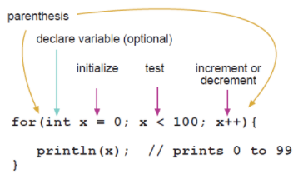
Control structure cont…
for statement
The for statement is used to repeat a block of statements enclosed in curly braces. An increment counter is usually used to increment and terminate the loop.

Slide 15
Control structure cont…
while
while loops will loop continuously, and infinitely, until the expression inside the parenthesis, () becomes false.
Syntax;
while(expression){
//statement(s)
}

Slide 16
Other control structures you need to know
switch case
do…while
break
continue
return
goto

Slide 17


